Slide 1
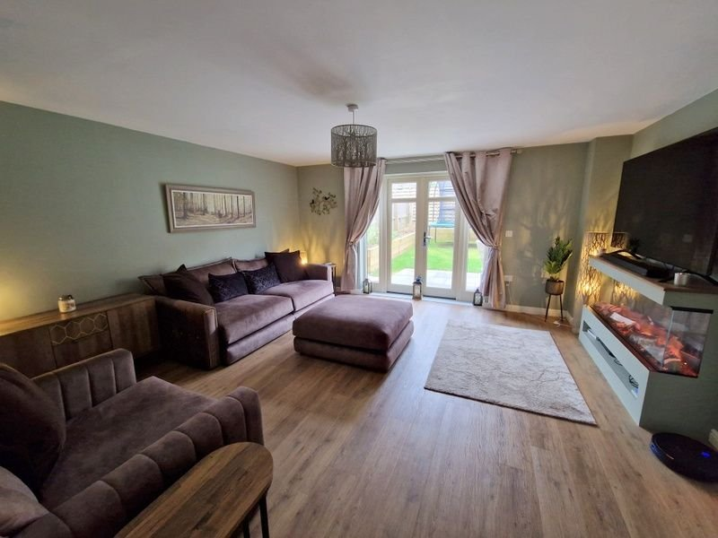
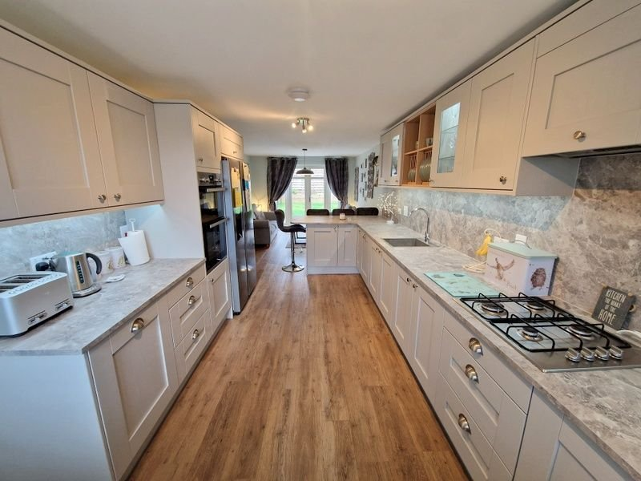
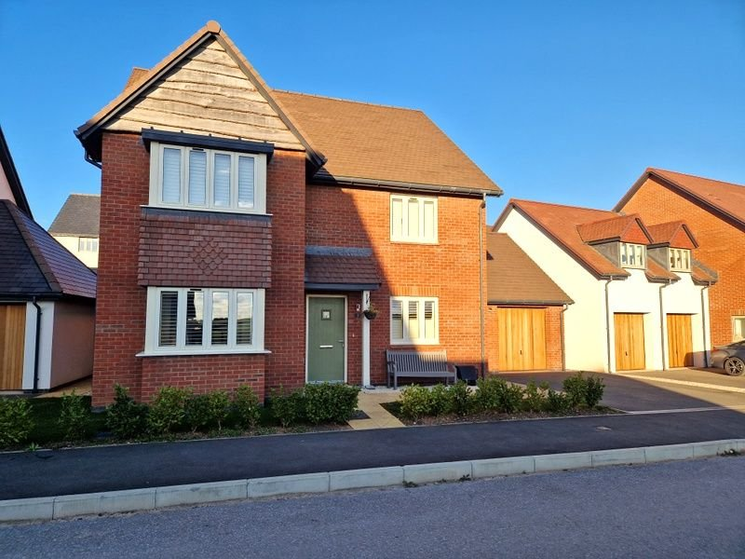
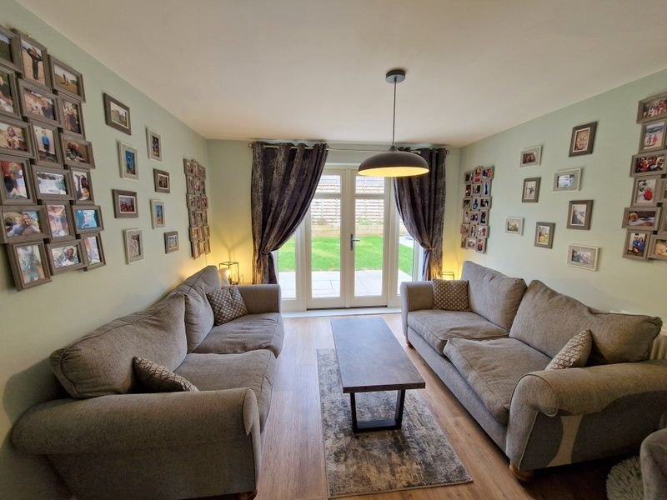
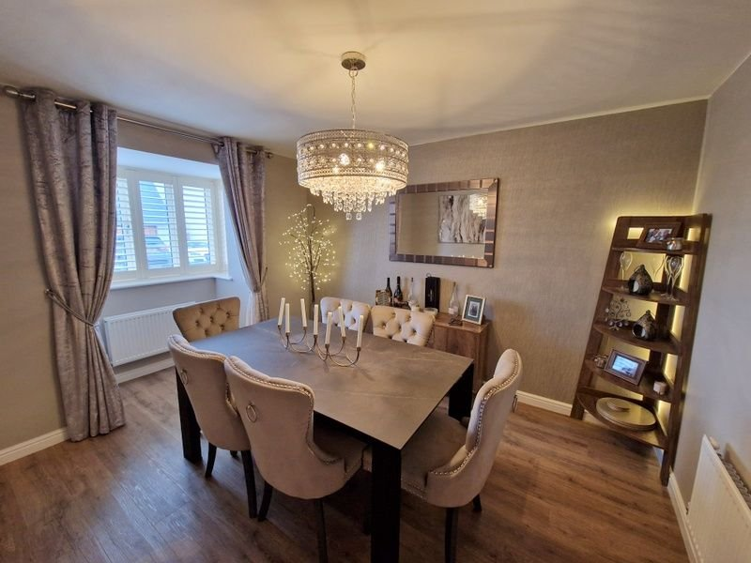
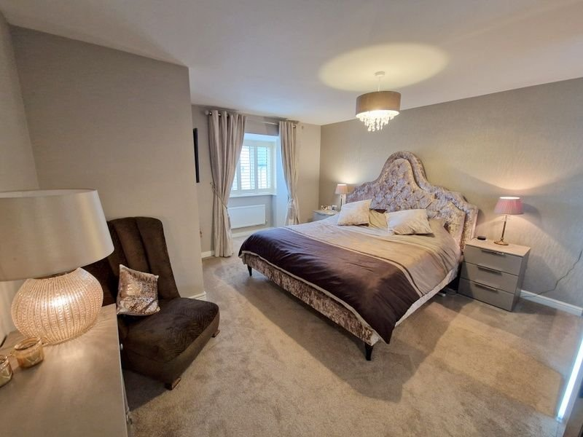
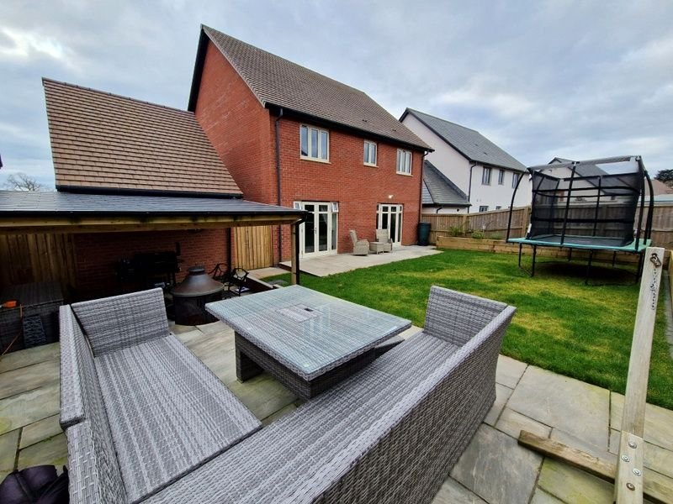
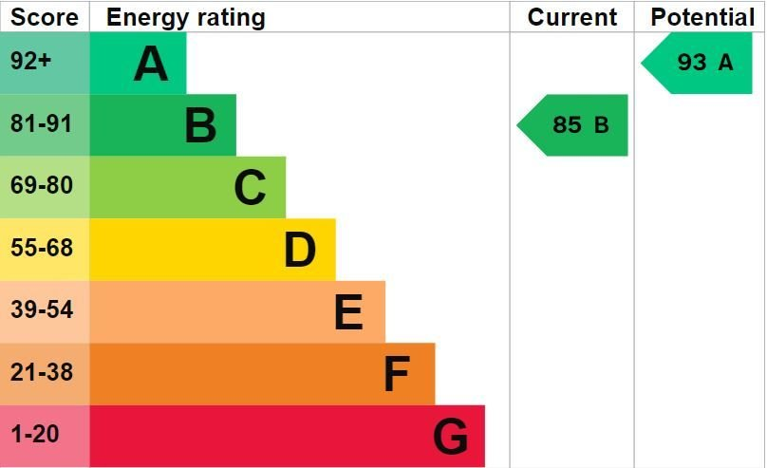
www.pennys.net
3 Taylor Crescent, Exmouth, EX8 2FT
PRICE £625,000
TENURE Freehold
An Exceptional Detached Residence Enjoying An Enviable Location On A Highly Desirable Development Enjoying Countryside Views
Spacious Well Proportioned Accommodation •
Stunning Re-fitted High Quality Kitchen/Breakfast/Family Room •
Attractive Lounge • Separate Dining Room • Utility Room/WC •
Family Bathroom/WC • Four Bedrooms • Recently Landscaped Rear Garden •
Double Width Driveway • Single Garage •
Viewing Highly Recommended •
Pennys Estate Agents Limited for themselves and for the vendor of this property whose agents they are give notice that:- (1) These particulars do not constitute any part of an offer or a contract. (2) All statements contained in these particulars are made without responsibility on the part of Pennys Estate Agents Limited. (3) None of the statements contained in these particulars are to be relied upon as a statement or representation of fact. (4) Any intending purchaser must satisfy himself/herself by inspection or otherwise as to the correctness of each of the statements contained in these particulars. (5) The vendor does not make or give and neither do Pennys Estate Agents Limited nor any person in their employment has any authority to make or give any representation or warranty whatever in relation to this property.
PENNYS ESTATE AGENTS
2 Rolle House, Rolle Street, Exmouth, Devon, EX8 2SN
Tel: 01395 264111 EMail: help@pennys.net

Slide 2
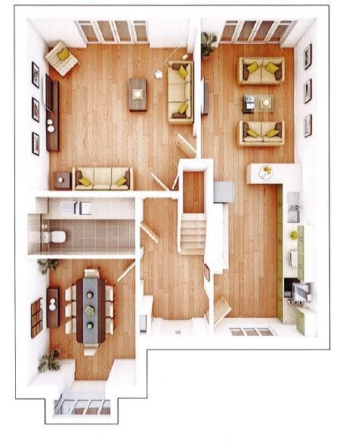
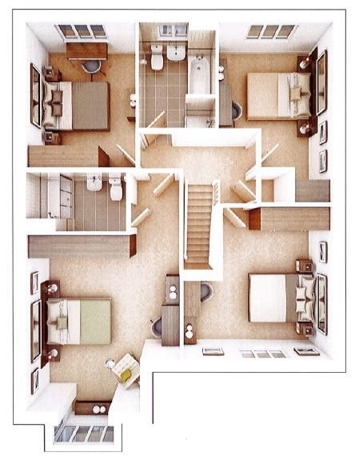
3 Taylor Crescent, Exmouth, EX8 2FT
THE ACCOMMODATION COMPRISES: PILLARED ENTRANCE CANOPY: With composite front door and courtesy light to: RECEPTION HALL: Radiator; cupboard housing electric consumer unit and meter; stairs to first floor landing. UTILITY ROOM/WC: 3m x 1.65m (9'10" x 5'5") Fitted with wood effect worktop surfaces with matching splash backs; cupboards and integrated washing machine beneath; wall mounted cupboards; radiator; WC with push button flush; ceiling extractor fan. DINING ROOM: 3.48m x 2.97m (11'5" x 9'9") Into double glazed square bay window fitted with wooden window shutters; two radiators. LOUNGE: 4.78m x 4.72m (15'8" x 15'6") A most attractive room with bespoke inset electric living flame fire with display surface over and shelf beneath; television point; radiator; double glazed double doors to rear garden; understairs cupboard. KITCHEN/BREAKFAST/SITTING ROOM: 8.81m x 2.9m (28'11" x 9'6") (Accessed from both Reception Hall & Lounge). Re-fitted with a high quality kitchen providing a wonderful 'hub' of the house comprising a range of worktop surfaces with matching splash backs extended to provide a breakfast bar area; inset sink unit with mixer tap; cupboards, drawer units and integrated dishwasher and recycling/refuse bin beneath; built-in oven and grill; space for large fridge freezer; wall mounted cupboards including display units and plate rack; two radiators; extractor fan; double glazed window to front aspect with fitted wooden shutters and double glazed doors and windows to REAR GARDEN. FIRST FLOOR LANDING: Access to loft space via ladder; radiator; airing cupboard with water tank and shelving; doors to: BEDROOM ONE: 6.27m x 4.06m (20'7" x 13'4") (Narrowing to 15'0" 4.57m) Excluding double glazed square bay window with fitted wooden window shutters and enjoying a wonderful rural outlook. A stunning and spacious main bedroom; television point. EN-SUITE SHOWER ROOM/WC: 2.67m x 1.52m (8'9" x 5'0") Double width shower cubicle with sliding shower screen doors; pedestal wash hand basin with splash back and mirror fronted medicine cabinet over; WC with push button flush; radiator; ceiling extractor fan. BEDROOM TWO: 4.01m x 3.99m (13'2" x 13'1") Into wall recess. Double glazed window with fitted window shutter enjoying lovely rural views; radiator. BEDROOM THREE: 3.91m x 2.87m (12'10" x 9'5") Double glazed window to front aspect; radiator. BEDROOM FOUR: 3.76m x 2.74m (12'4" x 9'0") Plus wall recess fitted with display shelf. Double glazed window to rear aspect; radiator.
BATHROOM/WC: 2.84m x 2.03m (9'4" x 6'8") Comprising of bath; pedestal wash hand basin with tiled splash prone areas; shower cubicle with folding shower screen; WC with push button flush; radiator; double glazed window; ceiling extractor fan. OUTSIDE: To the side of the house is a double width driveway leading to a SINGLE GARAGE: With up and over door and power and light connected. There is an attractive front garden area with lawn garden, shrub beds and decorative stone seating area. Two wooden side gates and patio pathway leads to the rear garden. The rear garden is a wonderful feature having been recently landscaped to comprise patio sun terrace areas including a covered patio area with outside power sockets and lights providing an excellent outside entertaining area, raised flower beds, level lawn garden, outside tap and lighting.
FLOOR PLAN:

